Slide 1

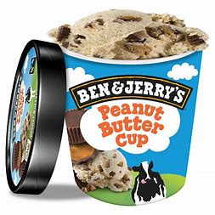
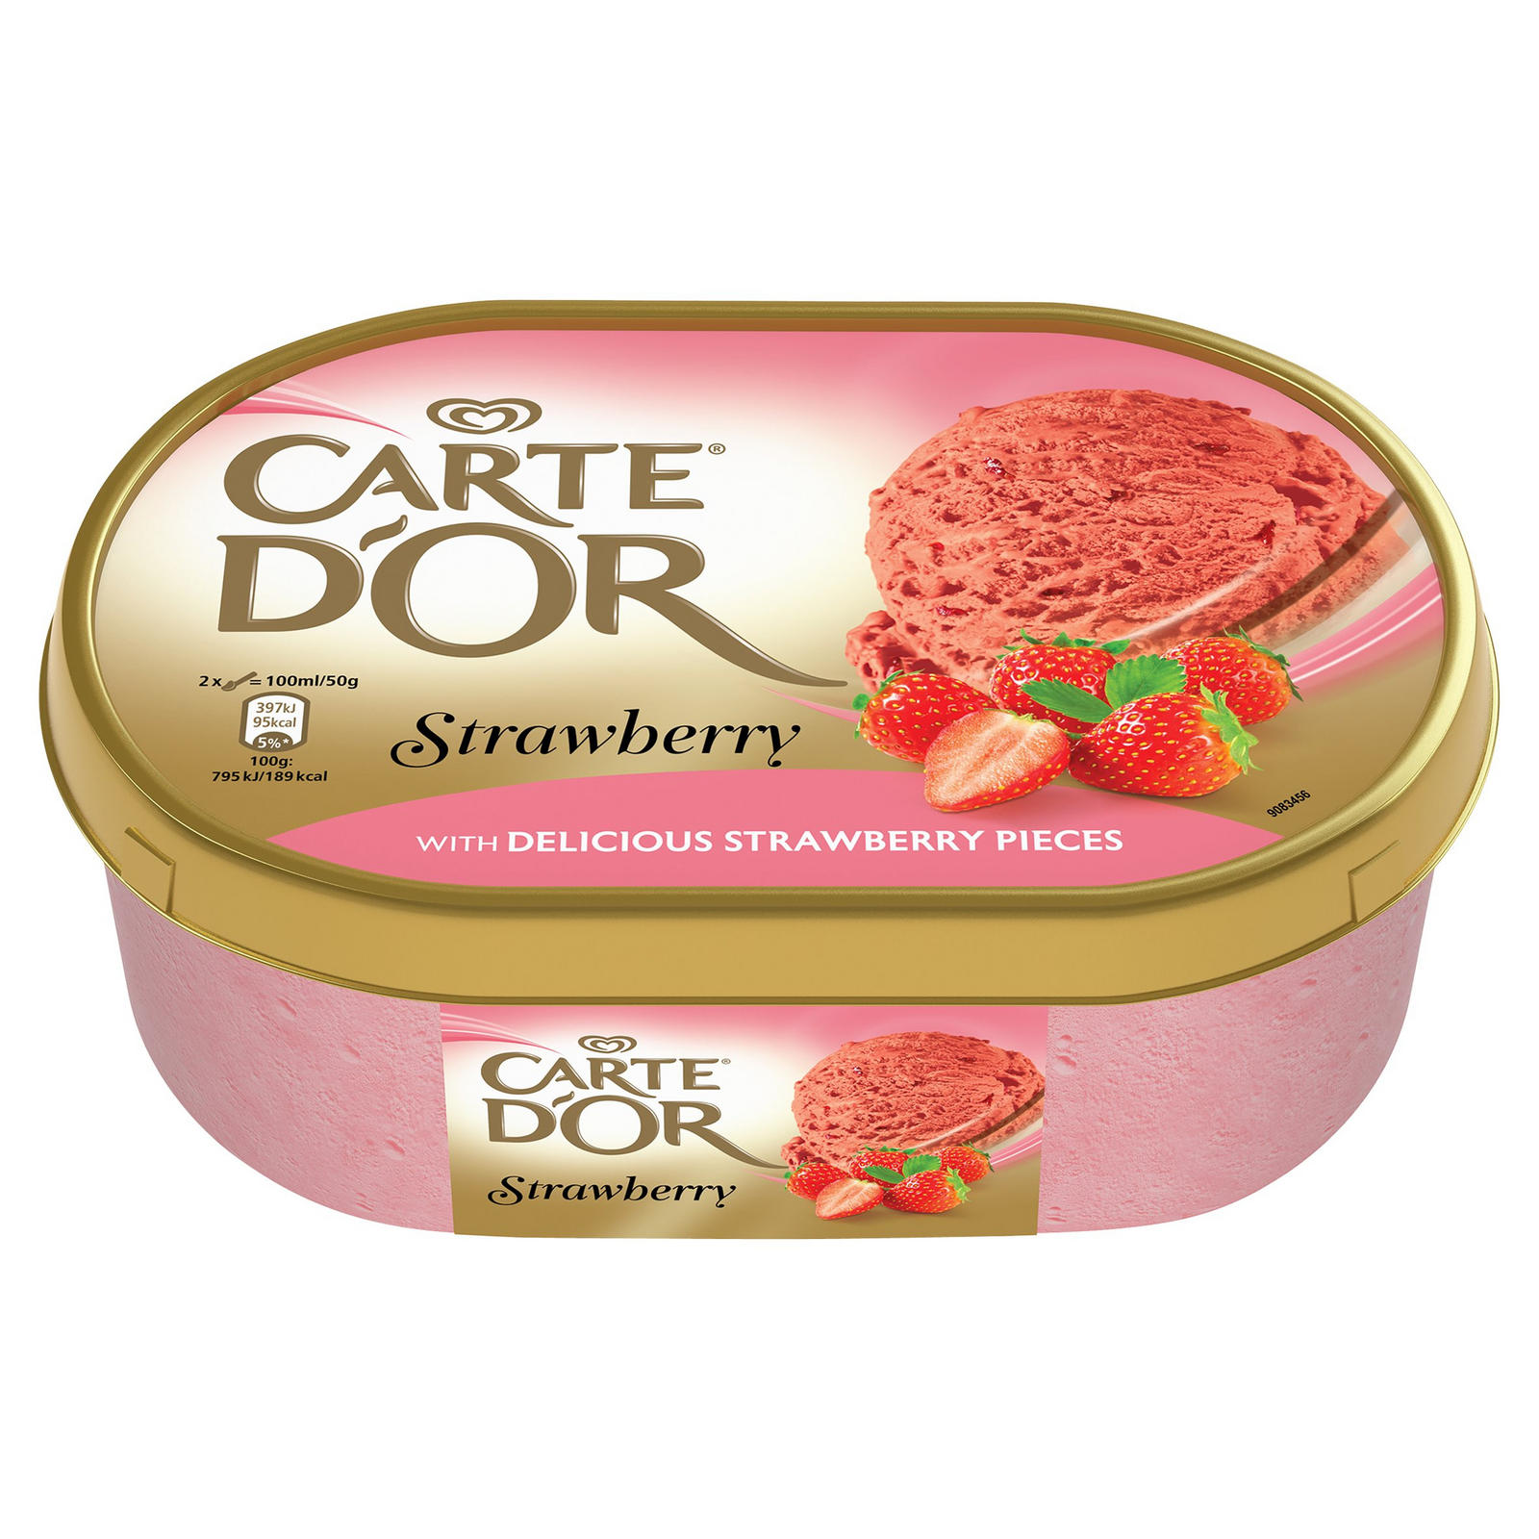
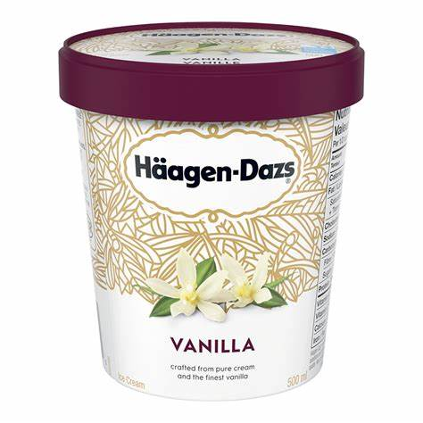
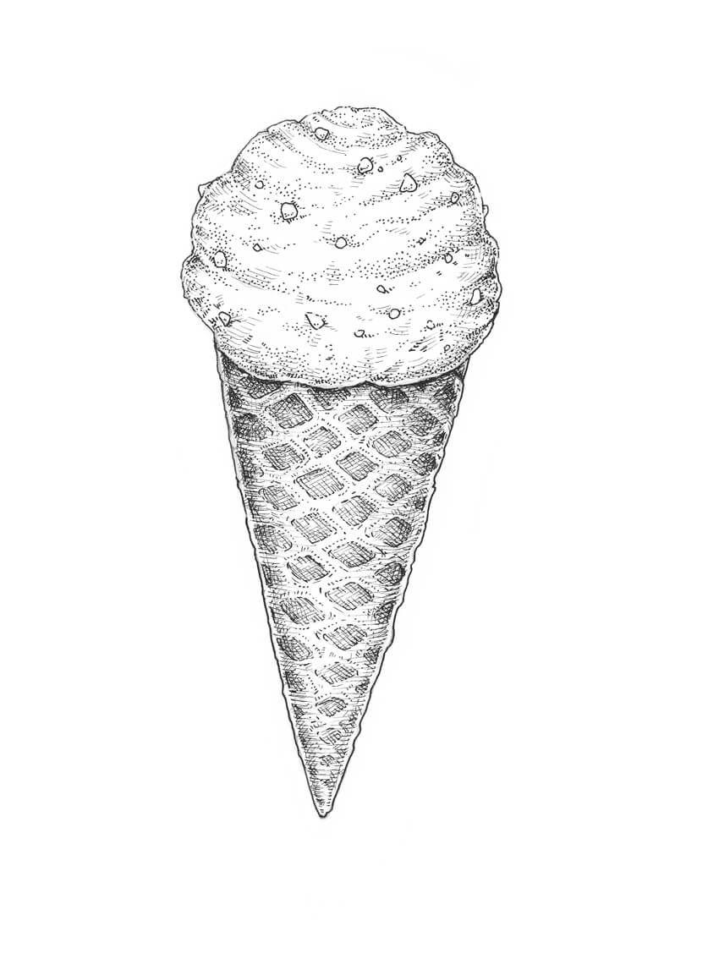
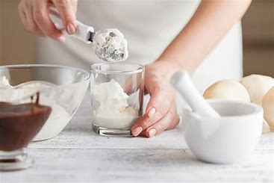
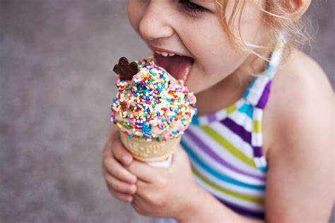
Design and Technology – Year 5
Key Vocabulary
Word | Description
Packaging | Materials used to wrap or protect goods.
Advertising | Where a product Is promoted for the attention of the public.
Logo | A symbol or small design that identifies a product or organization.
Label | A small of paper, fabric or plastic attached to an object and giving information about it.
Product | An object that is manufactured for selling.
Stackable | Can piled and neatly arranged.
Nutritional | Providing the food necessary for health and growth.
Freezable | Capable of being frozen.
Key Learning
To identify the key features of successful packaging.
To design effective packaging for a new flavour of ice cream.
To create a marketing poster.
To create a TV advert.
To produce packaging for a product.
To work as a team to create a new ice cream flavor.
To evaluate the effectiveness of the final product.
Packaging
Brand name.
Appearance of ice cream.
Quality of ingredients.
Unique selling point.
Lettering and colour scheme.
Key information displayed on container.
Examples
Design
Make
Evaluate

Slide 2
