Slide 1
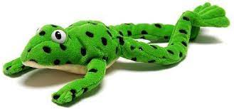
Phonics Screening Workshop 2025
Welcome!

Slide 2
Reading Changes Everything
"I think books are like people, in the sense that they’ll turn up in your life when you most need them."
Emma Thompson
"I can feel infinitely alive curled up on the sofa reading a book." –
Benedict Cumberbatch
"We don’t need a list of rights and wrongs, tables of dos and don’ts: We need books, time, and silence. Thou shalt not is soon forgotten, but Once upon a time lasts forever."
Philip Pullman

Slide 3
What is the Phonics Screening Check?
A word-reading check taken during the week commencing 9th June 2025.
Children read 40 words – 20 real words and 20 nonsense/psuedo words, either by sight or using strategies they have been taught to segment and blend to read.
The check takes no more than 10 minutes and is done on a 1:1 basis with a known adult.
The threshold is usually 32 words read correctly.
If they do not manage to meet the threshold in Year 1, they are given extra support, and repeat the check at the end of Year 2.
The aim is that all children will be able to read accurately before they begin Year 3.
All children are individuals, and all develop at different rates. The screening check ensures that teachers understand which children need extra support with phonic decoding.
They have not failed!

Slide 4

Green Words and Nonsense/Psuedo
(Alien) Words
Green Words
Nonsense Words
Words that can be read through decoding and blending.
Children are taught to notice there is no alien next to the word so it is a real word.
These are real words that have meaning.
Examples of green words:
chop green spoil
cobweb include
Words that can be read through decoding and blending.
Children are taught to spot the alien next to the word so they know it is not a real word.
These are not real words and have no meaning.
Examples of nonsense words:
joch reank lipe
braint skrinker

Slide 5

How are the results used?
Results from the check will be used by schools to analyse their own performance and for Ofsted to use in inspections.
Teachers will gain a better understanding of who needs support with decoding/blending.
Parents will have an understanding of whether their child is on track with their reading skills (results will be shared with parents at the end of the school year).
Passing the Check does not automatically mean they have completed their phonics learning. There are many more spelling rules and alternative pronunciations to learn before the end of Year 2.

Slide 6

What Can You Do To Help?
Listen to your child read everyday. This can be a book of their choice, but the more they read, the more exposure they are gaining!
Use the support material on their class pages to practise previous phonics screen check papers. This will allow them to gain confidence in seeing the material.
Encourage your child to read their Unlocking Letters & Sounds school books with confidence, fluency and expression.
When your child comes across a new word, encourage them to segment into the phonemes then blend them to read.

Slide 7
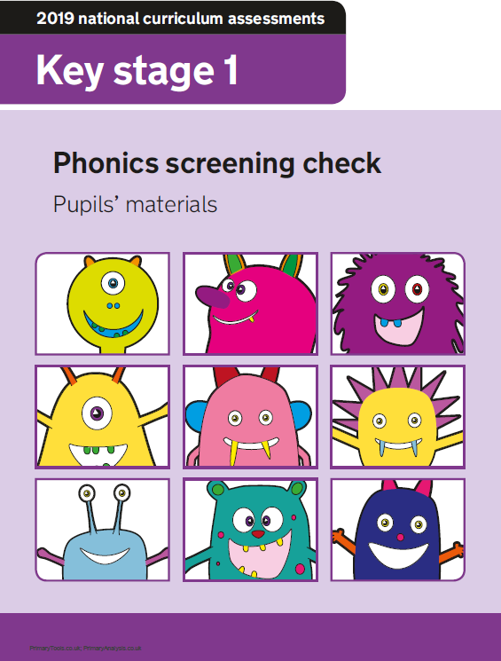

Questions?

