Slide 1
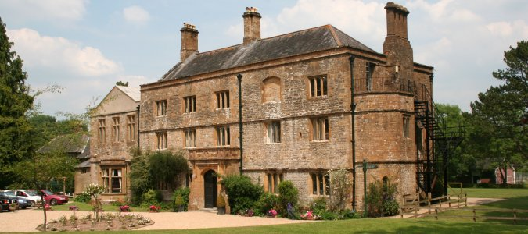
Hooke Court
21st – 23rd October 2026
Leave school at 10.30am
Arrive back at 2:45pm

Slide 2
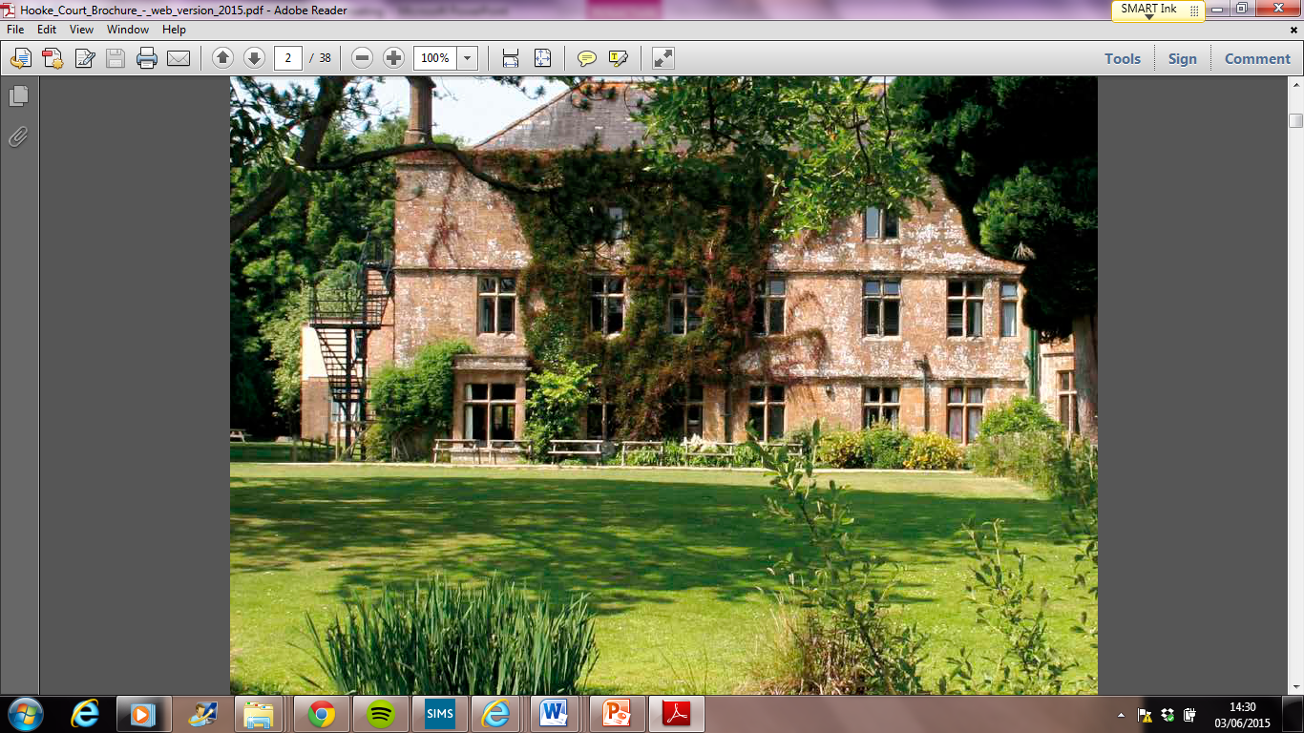
Hooke Court is a 14th Century manor house with a moat that is surrounded by beautiful grounds with a lake, woods and fields. These grounds are used for a vast variety of activities.

Slide 3
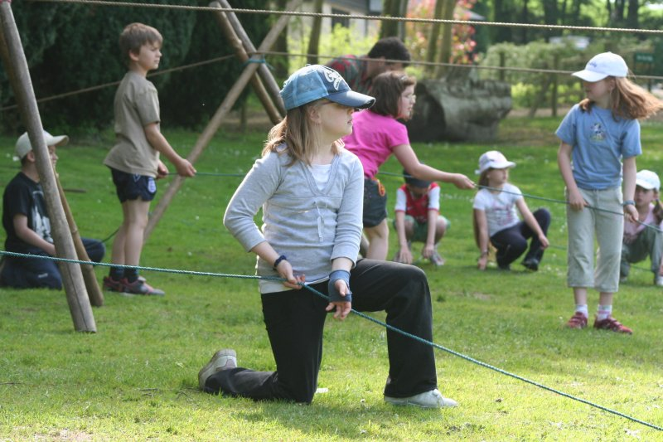
Activities
The aim of the residential is to build on the school values – Team work, Independence, Creativity and Challenge but in a different, outdoor environment.
All activities will be outdoors and led by fully qualified instructors.
Activities may well be physical. They will be very “hands on” and practical.

Slide 4
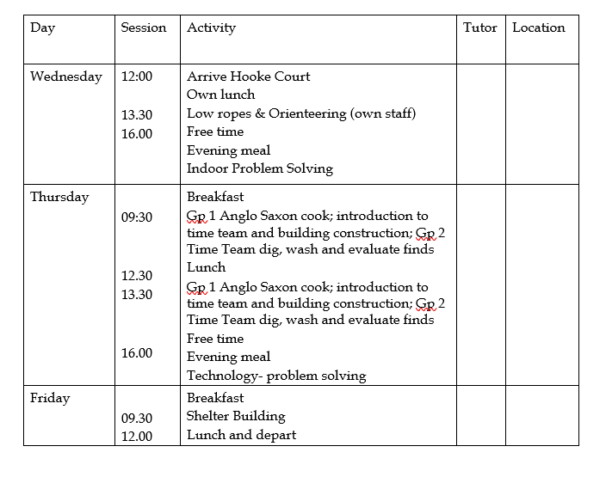
Itinerary

Slide 5
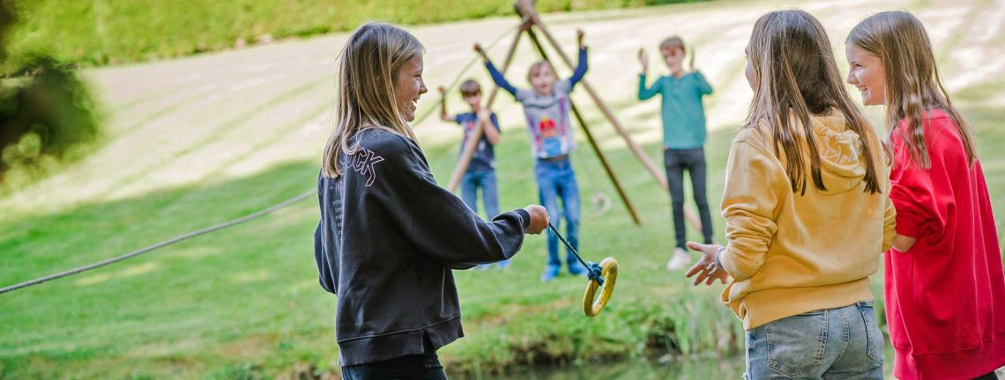
Outdoor Adventure Activities
Low Ropes and Orienteering
Working in small groups, the orienteering exercise will familiarise the children with their new surroundings and the low ropes course will provide them with a challenge to start working together and communicating well.
Shelter Building
In groups, the children have to decide on how to build a shelter big enough for all of them. They will have to consider how best to ensure it is safe and find all the necessary materials in the woods to build their shelter.

Slide 6
Evening Activities
Problem Solving
Work in small teams to solve problems by selecting and using appropriate materials.
Technology Problem Solving
A workshop looking at simple electrical circuits. Working in teams, the children have to design and build lighthouses with their own flashing lights.

Slide 7
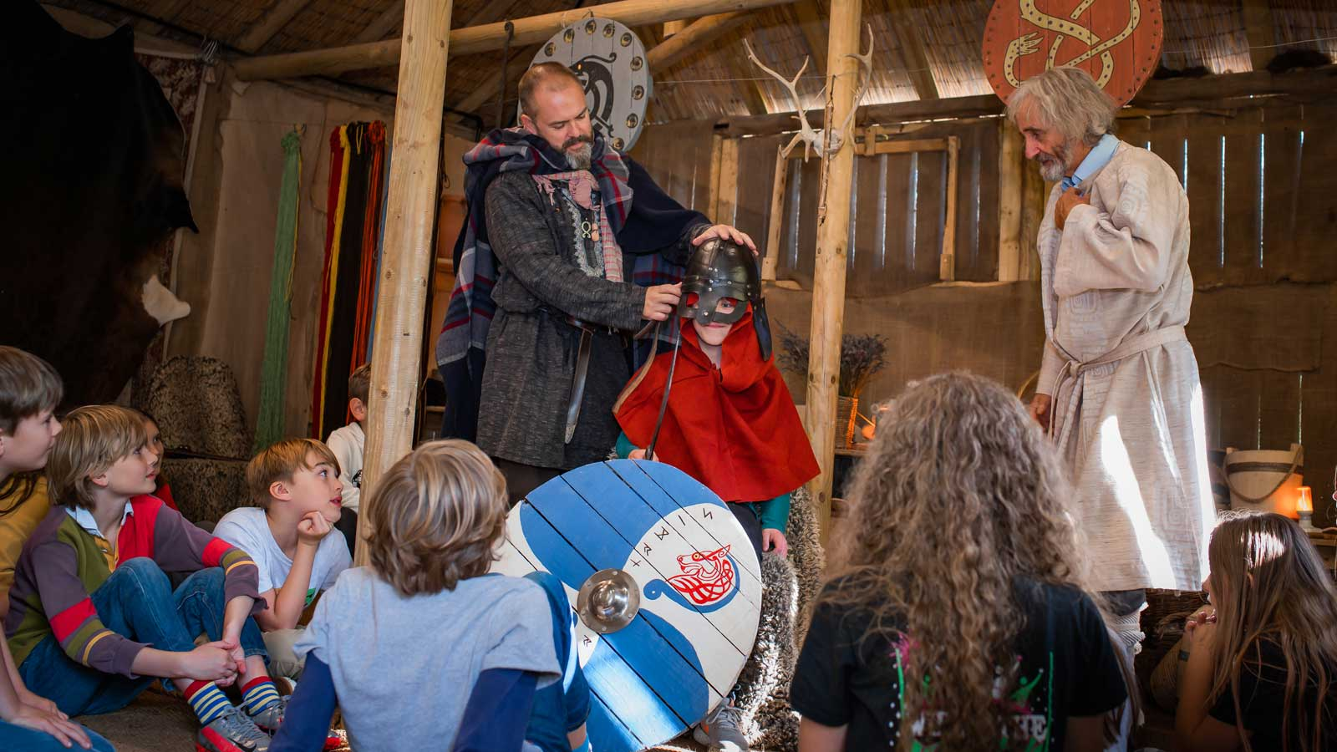
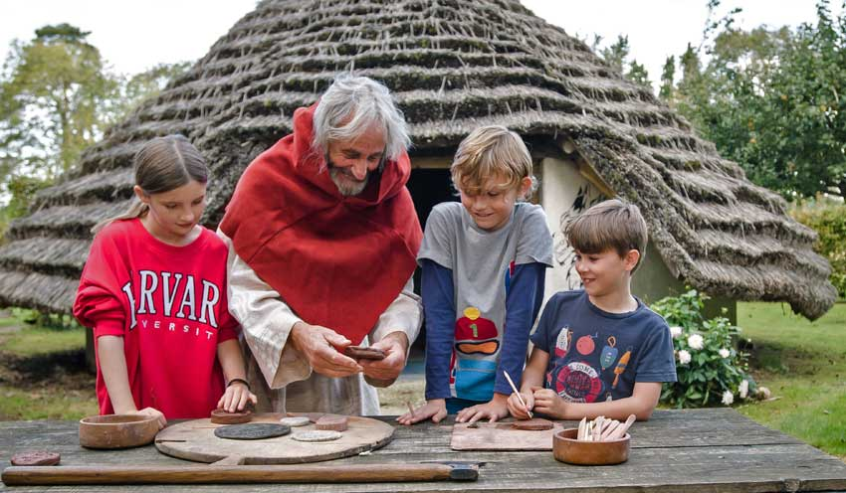
Saxon Day
Cooking
Time Team Dig
Building Construction

Slide 8
Kit
Children will have a kit list – old clothes please!
Wash kit with a towel
A waterproof coat with a hood will be essential
Warm clothes for outdoors will be needed. We will spend as much time as possible outside and cold feet need plenty of socks!
Wellington boots, sturdy trainers, indoor shoes and slippers
There is no need to buy new clothes.
Book, cuddly toy
Put the kit list inside their bag, as this will help when packing to come home.
Please name everything!

Slide 9
Kit
Carrier bags/ bin liner for dirty clothes
Named bag for welly boots
All children will need to bring a duvet/ sleeping bag.
Please name everything!

Slide 10
The children to do not need to bring
Electronic games/ devices
Aerosols
Mobile phones (a contact number will given on the letter)
Jewellery
Cameras
Money
Food containing nuts

Slide 11
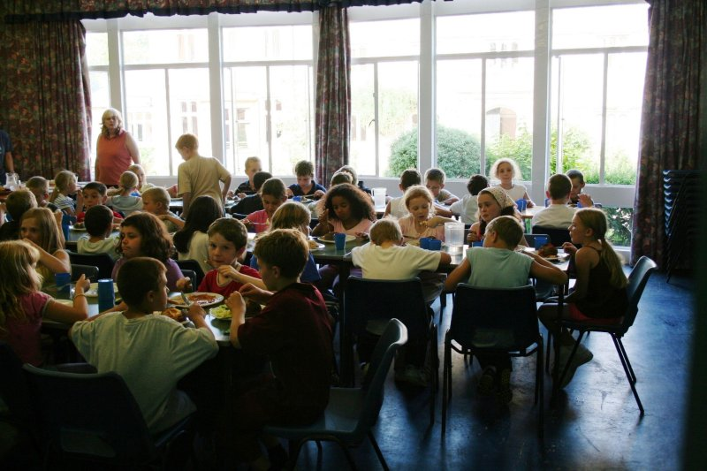
Food
Children will not go hungry!
All meals are provided, apart from DAY 1 LUNCH
Please provide a packed lunch for Day 1
No nuts please
Please also provide a non breakable and named drinks bottle.
We will always have drinks available and a hot drink at bedtime.

Slide 12
Medical and dietary requirements
Parental consent form for permission to administer paracetamol and ibuprofen, etc
Dietary requirements – please let us know as soon as possible
Medication will be taken to camp and administered by members of staff.
All medication needs to be given to a specific adult on the Wednesday morning.
Travel sickness pills - please make sure that the children take them before travelling on the morning of 21st October and have some for the return journey.

Slide 13
Sleeping
Children sleep in fully central heated, bunk-bedded rooms
4-7 children in a room
Each accommodation unit has its own common room, showers, toilets, boot room and kitchenette for making hot and cold drinks.
All children and staff are in the same building.
Children have had the chance to say who they want to be with and we will allocate rooms.
All rooms will be named and the children will know who is in which room – including where the adults are.

Slide 14
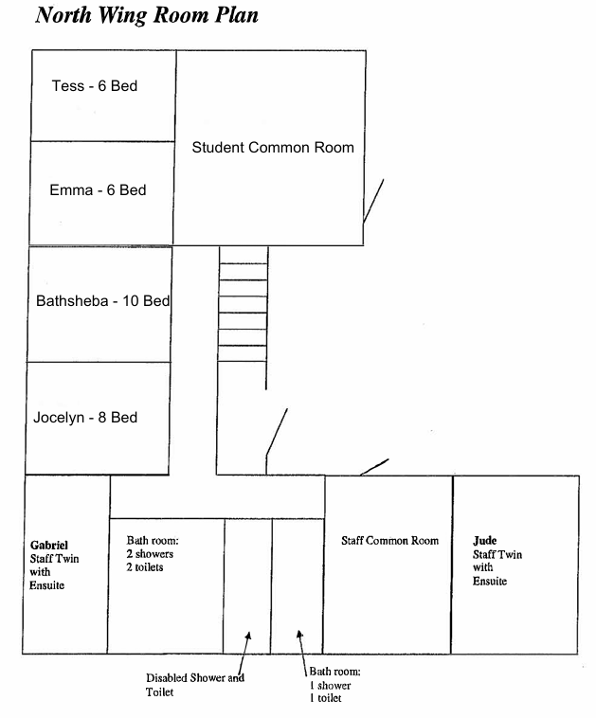
Sleeping

Slide 15
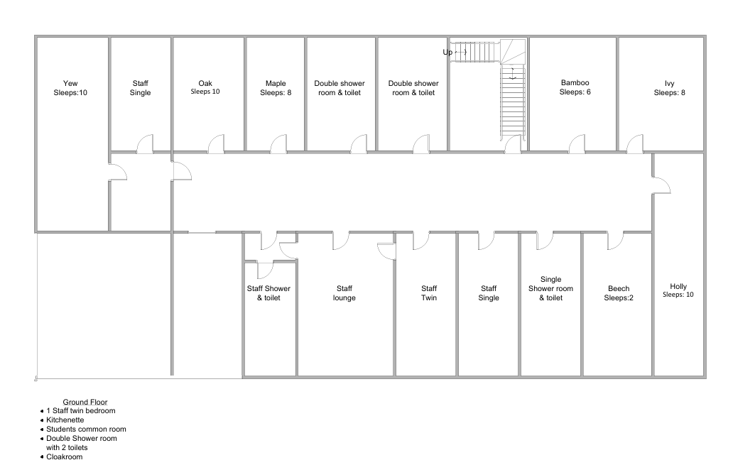

Slide 16
Before we go…
Please complete:
  Behaviour Contract
  Medical Consent including dietary requirements
  Check the kit list
  Please return forms to office by Friday 9th October.

Slide 17
Any questions…….

