Slide 1

Phonics Screening Workshop 2026
Welcome!

Slide 2
Reading Changes Everything
“Teach a child to read and keep that child reading and we will change everything… and I mean everything.”
Jeanette Winterson

Slide 3
Some statistics
In December 2018, research found that nearly 90% of children who passed the phonics check taken in Year 1 reached or exceeded the expected standard in reading in Year 6.
Accurate word-reading at age 6 is a good predictor of future reading success.
Targeted, sustained phonics intervention throughout key stage 1 and 2 is essential to prevent later reading difficulties. For these pupils, the phonics screening check is not an endpoint but a signal for intensified support.

Slide 4
What is the Phonics Screening Check?
A word-reading check taken during the week commencing 8th June 2026.
Children read 40 words – 20 real words and 20 nonsense words, either by sight or using decoding strategies.
The check takes no more than 10 minutes and is done on a 1:1 basis.
The threshold is usually 32 words read correctly.
If they do not manage to read 32 of the words, they are given extra support, and repeat the check at the end of Year 2.
The aim is that all children will be able to read accurately before they begin Year 3.
All children are individuals, and all develop at different rates. The screening check ensures that teachers understand which children need extra help with phonic decoding.

Slide 5

Green Words and Pseudo Words
Green Words
Pseudo Words
Words that can be read through decoding and blending.
Children are taught to ‘spot the special friend’, ‘Fred talk’ and then ‘read’.
These are real words that have meaning.
Examples of green words:
ch-o-p g-r-ee-n s-p-oi-l
c-o-b-w-e-b i-n-c-l-u-d-e
Words that can be read through decoding and blending.
These are not real words and have no meaning.
Examples of nonsense words:
j-o-ch r-ee-nk l-i-p-e
b-r-ai-n-t s-r-i-nk-er

Slide 6
How are the results used?
Results from the check will be used by schools to analyse their own performance and for Ofsted to use in inspections.
Teachers will gain a better understanding of who needs support with decoding/blending.
Parents will have an understanding of whether their child is on track with their reading skills (results will be shared with parents in end of year reports).

Slide 7
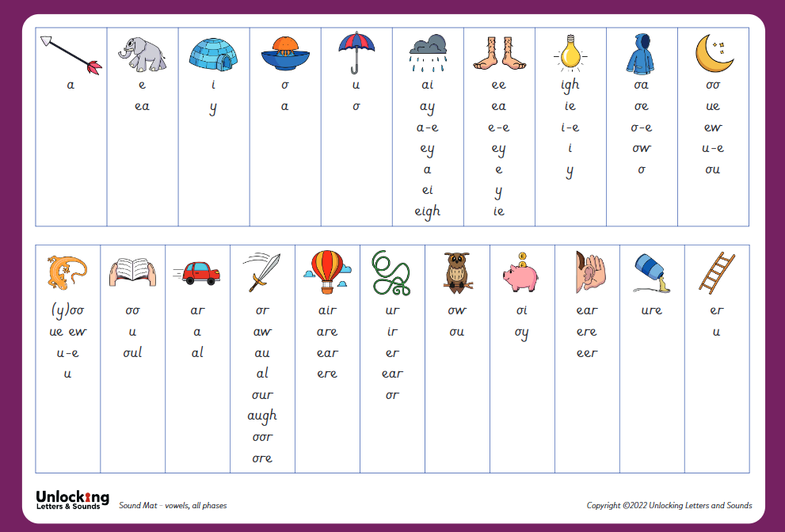
What can you do to help?
Listen to your child read everyday. This can be a book of their choice, but the more they read, the more exposure they are gaining!
Spot digraphs and trigraphs in their phonics books.
Ensure that they see the screen as a standard reading opportunity with a known adult, it is not something to be worried or anxious about.
Regularly practise phase 3 and 5 GPCs in a different order each time. Remind your child to say the pure sound

Slide 8
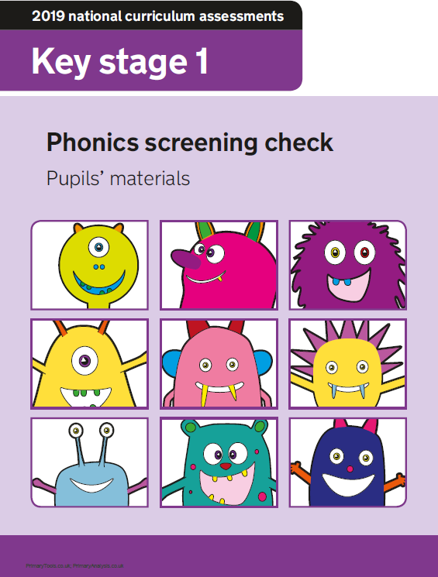

Questions?

